Slide 1
A Study Of The Book Of Revelation
August 29, 2021

Slide 2

Revelation 19:19
Revelation 19
Revelation 13:1.
“And I saw the beast, and the kings of the earth, and their armies, gathered together to make war against him that sat upon the horse, and against his army.”

Slide 3
Revelation 19:20
Revelation 19
Revelation 13:1.
“And the beast was taken, and with him the false prophet that wrought the signs in his sight, wherewith he deceived them that had received the mark of the beast and them that worshipped his image: they two were cast alive into the lake of fire that burneth with brimstone:”
Revelation 13:11; 16:13; 19:20
Revelation 14:11.
Revelation 14:9ff
Harlot burned with fire! Revelation 18:8
cf. Daniel 7:9-11

Slide 4
Revelation 19:21
Revelation 19
NOTE: “the rest” were not cast into the “lake of fire” until 20:11-15 … The final judgment!
“and the rest were killed with the sword of him that sat upon the horse, (even the sword) which came forth out of his mouth: and all the birds were filled with their flesh.”

Slide 5
Final Outcome
Revelation 19
Dragon and his allies seemed invincible
Fate of the two beasts “Cast into the lake of fire”
Results of Armageddon
666 utter defeat!
“The rest” “Cast into the lake of fire” (second death) (20:10,14,15, 21:8)
By being alive a sorer punishment!
Lake represents their utter defeat.

Slide 6
Final Outcome of Allies
Revelation 19
Fate of their allies:
Killed with the sword
Slain by the victorious Christ
Became the “main course” at God’s great supper!
Allies left for final judgment – too late for Rome – doom has been determined.
One behind all the troubles will not escape!
The Dragon? – He will be dealt with next!

Slide 7
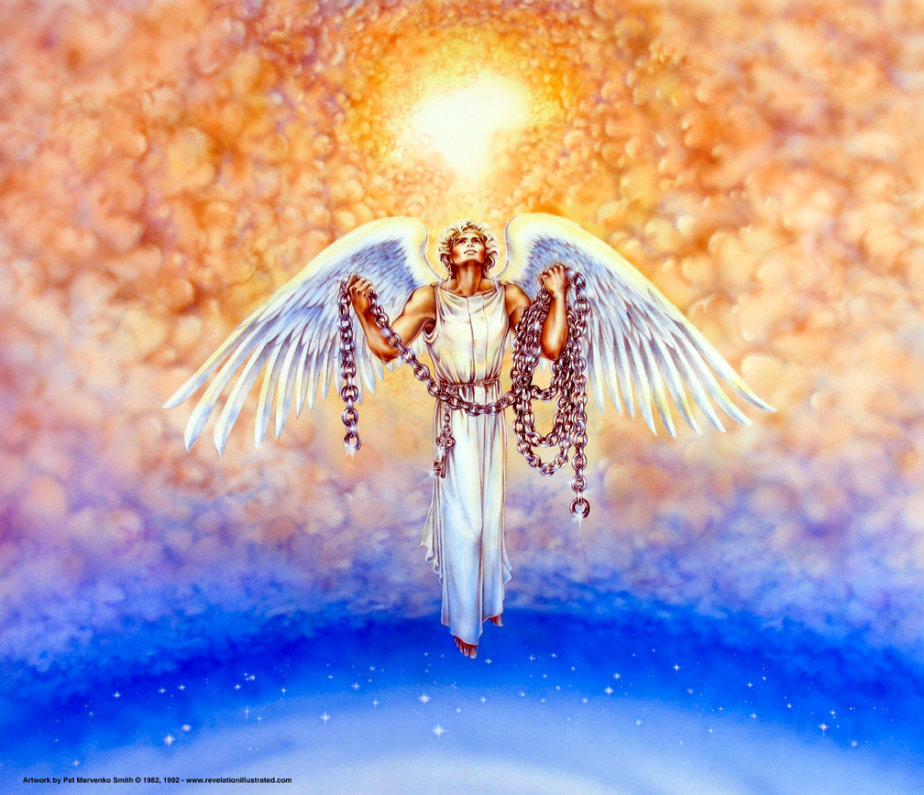
The Book of Revelation: Chapter 20
Revelation 20
Victory Over The Dragon and his Followers

Slide 8
Resources used:
A Study Of The Book Of Revelation by Bob Dodson
God’s Prophetic Word by Foy E. Wallace
More Than Conquerors by William Hendriksen
Overcoming With The Lamb, Florida College Annual Lectures, February 7-10, 1994
Outline of the Book of Revelation by John Robertson – Floral Heights Church of Christ https://floralheightschurchofchrist.org/Class%20-%20Bible%20Books/Revelation.pdf
Revelation – An Introduction and Commentary by Homer Hailey
Revelation (Truth Commentaries) by Robert Harkrider
Revelation (A Study Workbook) by Robert Harkrider
Revelation and charts by Donnie Rader
Revelation charts by Keith Greer
Studies In The Book Of Revelation by Ferrell Jenkins
The Apocalypse of St. John by Henry Barclay Swete http://biblicalstudies.gospelstudies.org.uk/pdf/e-books/swete_h-b/apocalypse-of-st-john_swete.pdf (540 pages)
The Old Testament In The Book Of Revelation by Ferrell Jenkins
The Revelation Of St. John The Divine by G.B. Caird
The Book of Revelation by Foy E. Wallace
The Avenging of the Apostles and Prophets by Arthur M. Ogden
Worthy Is The Lamb by Ray Summers
Written exchange on THE DOMITIAN PERSECUTION between Arthur M. Ogden and Ferrell Jenkins presented in Searching The Scriptures, June 12, 1989, pages 7-12

Slide 9
Revelation 20:1
Revelation 20
“And I saw an angel coming down out of heaven, having the key of the abyss and a great chain in his hand.”

Slide 10
Revelation 20:2
Revelation 20
“And he laid hold on the dragon, the old serpent, which is the Devil and Satan, and bound him for a thousand years,”

Slide 11
Revelation 20:3
Revelation 20
“and cast him into the abyss, and shut (it), and sealed (it) over him, that he should deceive the nations no more, until the thousand years should be finished: after this he must be loosed for a little time.”

Slide 12
Revelation 20 and False Theories
Revelation 20
The 4th Banner (14:13)— ”Christians triumph”
Revelation 20 has been a favorite text for religious speculators for centuries.
May be the most abused and misunderstood text in all of Scripture!
Many questions are asked and the answers vary depending on who is asking the questions!

Slide 13
Revelation 20 and False Theories
Revelation 20
When is the battle of Armageddon?
What is signified by the 1,000 year reign?
Why must Satan be let loose after he was sealed in the abyss?
First seven verses are the only ones in Scripture to mention a 1,000 year reign.
Whatever answers are found, they must be consistent with the rest of the Bible.
Also in harmony with the theme and purpose of the book of Revelation!
Theme of chapter 20—the defeat of Satan—not the 1,000 year reign! (cf. 1:18; 12:7-11; Hebrews 2:14-15)

Slide 14
DE
A
D
Meeting
Satan
Loosed
J.
W.
T.
Rapture
Revelation
Church
Age
Israel
7 years
tribulation
Millennium
J
Resurrection
R
RT

Slide 15
The Errors Of The Premillennial View Of The Rapture
Too many comings of Christ.
1. The Bible says Christ will come a second time (Acts 1:9-11; Hebrews 9:28; 1 Corinthians 15:23-24).
2. The premillennialist has Christ coming a second and third time and try to justify this by saying it is the second coming in phases.

Slide 16
The Errors Of The Premillennial View Of The Rapture
Too many resurrections from the dead.
1. Because of the misunderstanding of Revelation 20:4-6, dispensationalists by necessity must teach a plurality of resurrections.
(1) Church raised at the rapture.
(2) OT saints and tribulations saints raised when Christ comes to set up his kingdom.
(3) Wicked raised after millennium.

Slide 17
Revelation 20:1-6
a. This context is dealing with Christians who have been martyred.
b. This is picturing the victory of the martyrs underneath the altar (Revelation 6:9).
c. Those who had suffered under the great persecution are victorious in Christ.

Slide 18
Revelation 20:1-6
d. The cause for which they died has made them triumphant, and this is the first resurrection, that of the cause.
e. This is a spiritual resurrection and not a physical one; there is no justification for making this a bodily resurrection.

Slide 19
Revelation 20 and False Theories
Revelation 20
Premillennialists ignore many specifics that are stated and embellish the text with many assumptions
Text DOES NOT mention:
Second coming of Christ
Bodily resurrection
Reign “on earth”
Literal throne of David
Jerusalem or Palestine
“Us” instead of “they” who lived and reigned
Christ on the earth

Slide 20
Revelation 20
Revelation 6:9-11
Souls of slain
Under the altar
Crying for judgment
Scene of defeat
Revelation 20:4-6
Souls of beheaded
On thrones
Given judgment
Scene of victory
Chart adapted from Ferrell Jenkins, Studies in the Book of Revelation, page 33

Slide 21
LITERAL OR FIGURATIVE – WHICH? Revelation 19-20.
A WHITE HORSE AND RIDER.
ARMIES, HORSES, WAR
SWORD, OUT OF MOUTH
RULE, ROD OF IRON
TREAD THE WINE PRESS
NAME ON HIS THIGH
FOWLS FLY TO SUPPER
EAT FLESH, KINGS,
FOWLS FILLED WITH THEIR FLESH COMPASSED
BEAST, MARK, IMAGE
ANGEL COMING DOWN
KEY, CHAIN, PIT
DRAGON, TAIL, STARS
FROGS OUT OF MOUTH
BOUND – BOTTOMLESS PIT
SHUT – SEALED
THRONES – BEHEADED
PRISON, LOOSED, MEN, HORSES BATTLE
CAMP OF SAINTS
FIRE AND BRIMSTONE
GOD’S PROPHETIC WORD, by Foy Wallace, page 285

Slide 22
Binding of Satan
Revelation 20
Theme of chapter 20 — the defeat of Satan — not the 1,000 year reign! (cf. 1:18; 12:7-11; Hebrews 2:14-15)
Angel came down out of heaven
Key to “bottomless pit” (abyss)
Great “chain” in his hand
Literal — or Figurative?
Key — authority over the abyss
Chain — ability to limit the power of Satan
Confining to the abyss!

Slide 23
Binding of Satan
Revelation 20
Angel “laid hold” on the dragon — power over the dragon
Identified: dragon, serpent of old (Genesis 3), and Satan
Bound for “1,000 years” — until completed
Absolutely complete
Bound — constrained (confined) — limited
Not literal (Psalms 50:10; Deuteronomy 7:9)

Slide 24
Binding of Satan
Revelation 20
Why is he “bound or limited”?
Might not “deceive the nations” any more
Earthly ministry of Jesus (Matthew 12:28-29) — power of Christ greater
Resurrection (Hebrews 2:14-15) bondage of sin and death broken
His ability to destroy the church with deception (as in Rome) was taken away
No “world empire” ever sought to destroy the church as Rome did!

